Slide 1
Construal of a person in Arapaho complaints
Irina Wagner PhD Student University of Colorado Boulder Department of Linguistics

Slide 2


Acknowledgements
Northern Arapaho Language and Culture Commission
Dr. Andrew Cowell (University of Colorado Boulder)
Dr. Barbara Fox (University of Colorado Boulder)
The Department of Linguistics (University of Colorado Boulder)
Center of Studying Indigenous Languages of the West
University of Colorado’s United Government of Graduate Students.

Slide 3
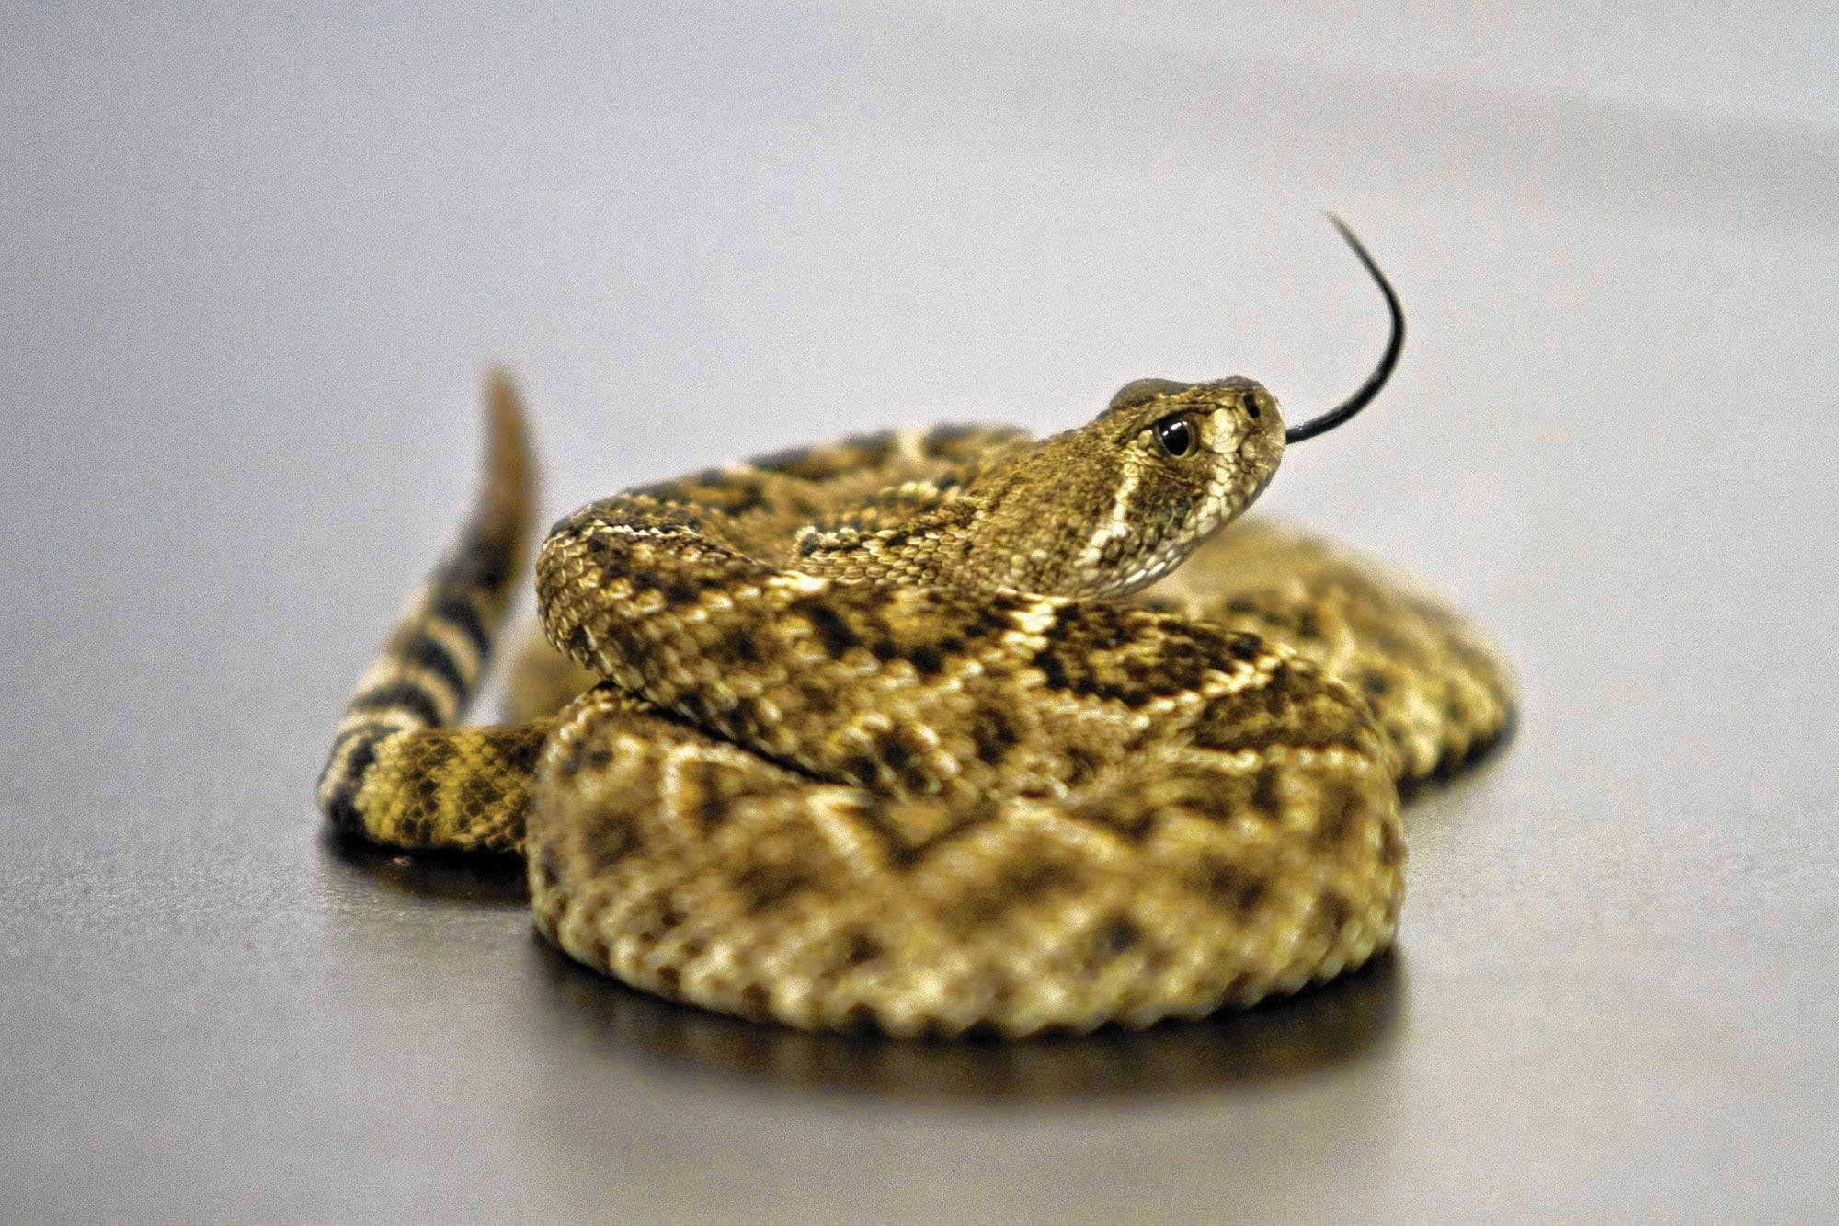
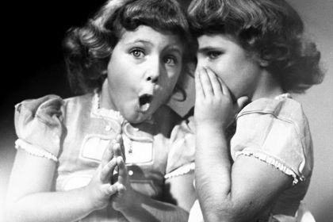
Gossiping in Arapaho culture

Slide 4
The background of the study
Preliminary research on person reference terms shows slight deviations from the basic principles (Sacks & Schegloff 1979).
Preference for kin terms is more significant.
Dependence on the projected action & on the thematic domain:
Praise & positive assertions trigger kin terminology;
Sense of cultural pride evokes traditional Arapaho names;
English names are mainly used in work-related environments;
Complaints never include names and steer towards the “longer” terms of reference, e.g., relative clauses.

Slide 5
Theoretical background
Speakers rely on structural (1) and cultural (2) premises in formulation of reference:
(1) principles of minimization and recognition (Sacks & Schegloff, 1979), relevant role (De Fornel, 1987)
(1) reference can negotiate conversational structure (Schegloff, 1996; Fox, 1984),
(1) reference often aligns with conversational action (Stivers, 2007)
(2) circumspection (Levinson, 2007)
(2) association (Brown, 2007)

Slide 6
In general, communities of practice prioritize some principles over others in formulation of reference according to the salient features of person identification (Enfield, 2007).

Slide 7
Main question
What are the strategies for identity construal in complaints:
What are the linguistic devices helping to construct reference?
How is vagueness rendered in identifying a person?
How is ambiguity avoided?
How such terms of reference are understood by the addressees?

Slide 8
Data
Endangered Languages and Documentation Program grant to record naturally occurring conversations in Arapaho (2008-2010)
Data recorded, transcribed, and translated by the Center of Indigenous Languages of the West at the University of Colorado Boulder.
Data available in Endangered Languages Archive.

Slide 9
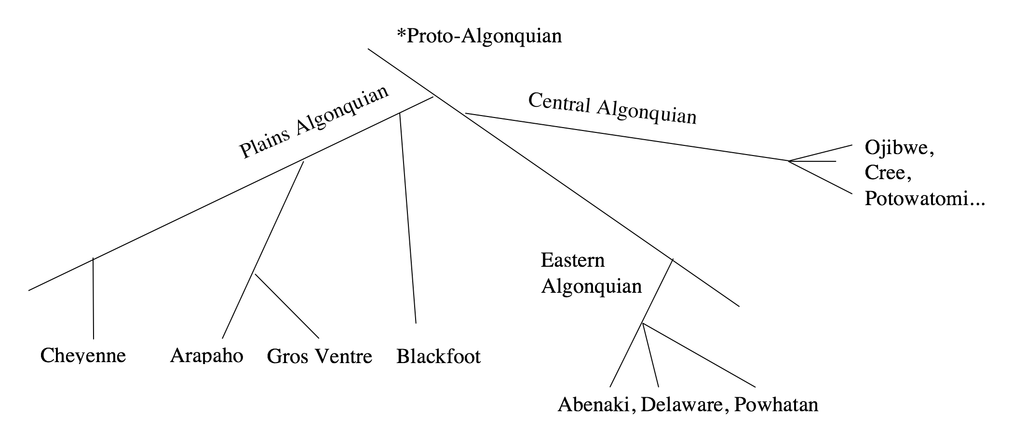
Arapaho

Slide 10
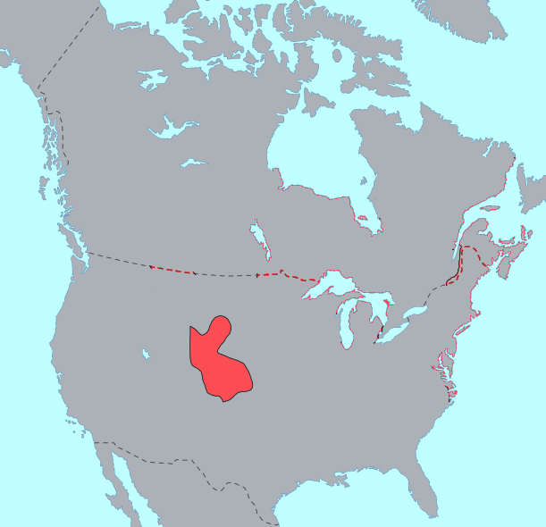
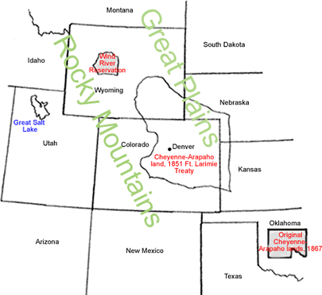
Arapaho
Wind River Indian Reservation
Wyoming, USA
< 5,000 enrolled
<100 native fluent speakers

Slide 11
Linguistic note
Poly-synthetic agglutinating language
NP’s are infrequent
Most references can be done with verbal inflections
References can also be done by:
Names (Anglo, Arapaho)
NP (membership categorization)
Relative Clause (descriptor, membership categorization)
Determiners (anaphoric)
Pronominal elements (anaphoric)
Verbs (anaphoric)
Inflections (anaphoric)

Slide 12
Complaint problem
Multi-turn & multi-speaker engagement.
“complaints cannot simply be defined as particular expressions of discontent that are produced unilaterally by one of the participants” (Heinemann, 2009, p. 2382)
Don’t always exhibit marked expressions.

Slide 13
Methodology
Used 5 hours of naturally-occurring conversations about people.
Complaints were extracted on the base of negative assertions and response (agreement/disagreement/sympathy) of the addressee.
Total of 12 complaints about third party.
The form of person reference is recorded, also recorded previous mention of same person, if any.

Slide 14
Types of Person References
Targeted individuals:
Specific unnamed people deduced from the context of talk.
Targeted “others”:
Named group of people to whom neither of the speakers belong.
Everyone in the community:
Generalized people of the whole community based.

Slide 15
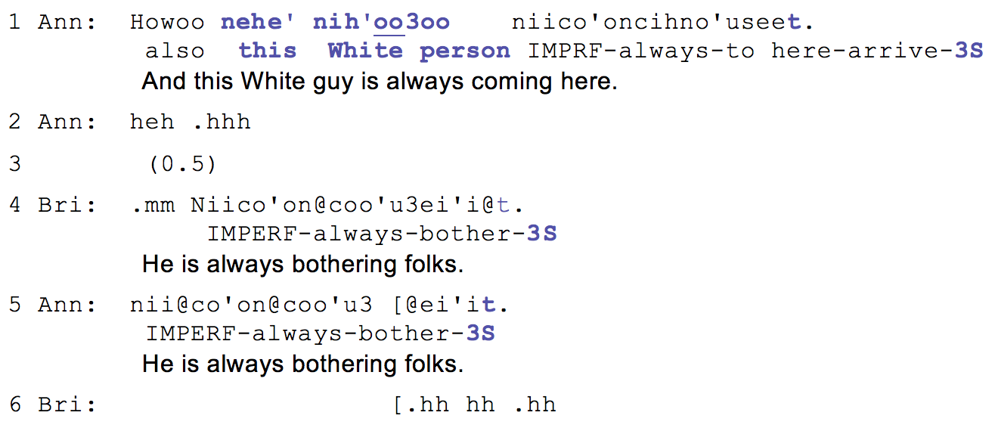
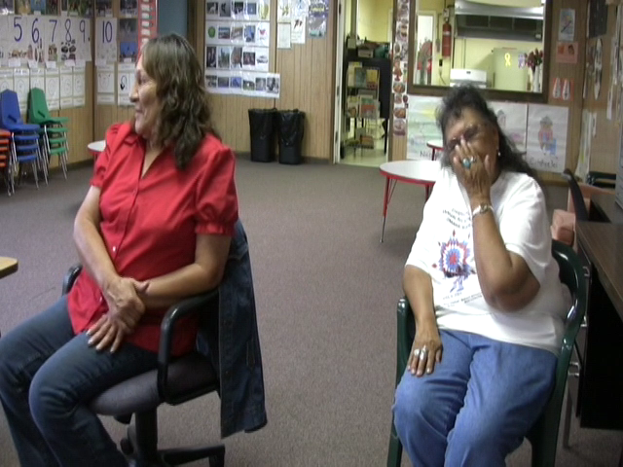
Targeted individuals
Example (1). 47a (04:01-04:07)
Notes:
You know them from the context. They may have been vaguely identified, but never by name.
In example 1, the referent is present during the recording – he is the one doing recording. He speaks the language fluently and the speakers know him well by name, either traditional or the Anglo.
Vera begins a new sequence of a complaint by attributing it to the anthropologist behind the camera. In line 1, she refers to him with a noun phrase “Nehe’ Nih’oo3oo” this white man (trickster). She boosts her complaint by adding a prefix co’on- “always” which is picked up by Iris in the second position with agreeing addition. Importantly, the speakers do not provide any additional identifying information about the researcher, neither do they use pointing to disambiguate his identity. In fact, his identity seems to be hidden from other participants, notably researcher himself, and it is largely deduced from the context of a conversation. After the initial introduction of the referent in line 1, both of the interlocutors resort to anaphoric personal inflection eventually turning the complaint into a joke.

Slide 16

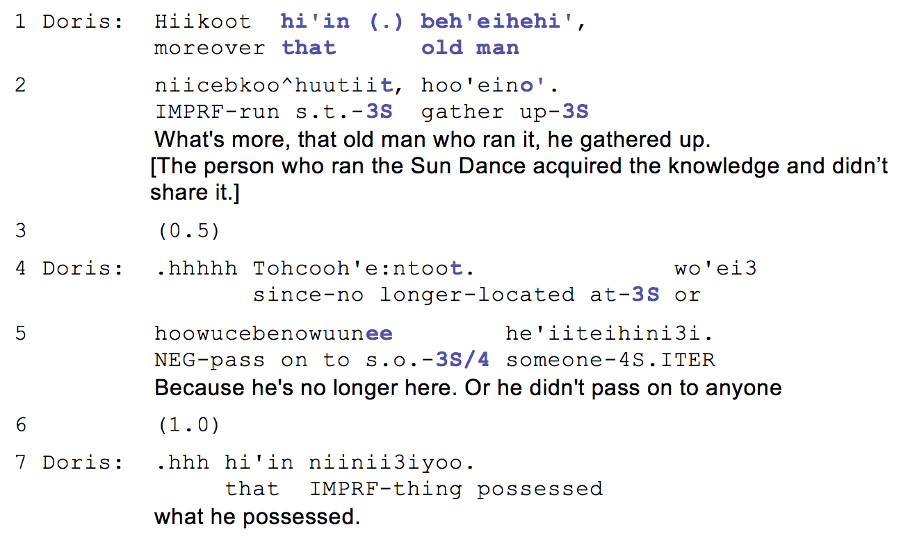
Targeted individuals
Example (2). 21b (06:50-07:00).
Notes:
This example is taken from a conversation between husband and wife. In this part, they are discussing the loss of culture in their community. They attribute its loss to the elders who are unwilling to share their knowledge with the rest of the people.
The target reference is in line 1. Note that neither of the speakers have mentioned the particular elder prior to this turn. Yet, the speaker formulates the reference using the demonstrative pronoun hi’in which intrinsically suggests “aforementioned.” To identify the referent, the speaker uses a descriptive noun phrase that can be loosely translated as “the old man who ran Sun Dance.” The status of the referent is highly privileged – the person who runs Sun Dance is elected by elders of the community for several years. So, Doris’s complaint is potentially problematic because it can be seen as undermining that man’s authority. Using a vague reference here though allows her to hold on to her own dignity without openly criticizing the man, but at the same time it creates enough reference for her husband to understand who she’s talking about without forming a repair in the following sequence.

Slide 17
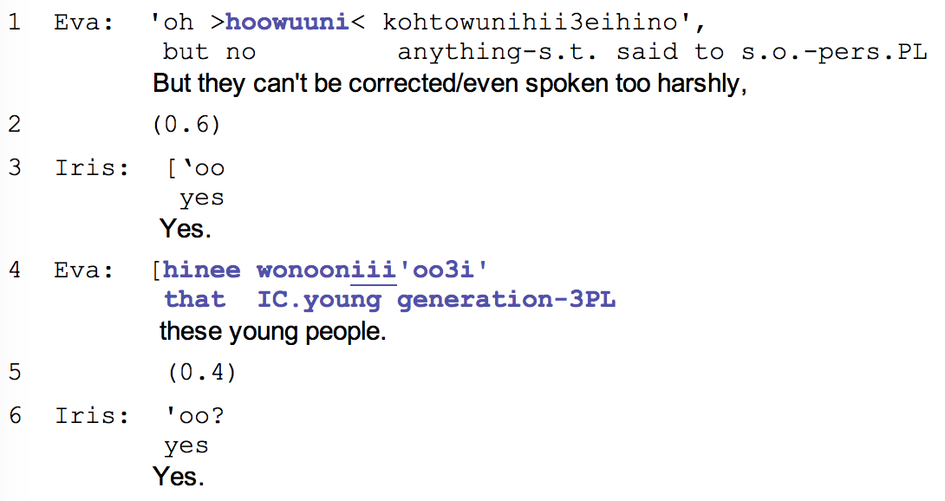
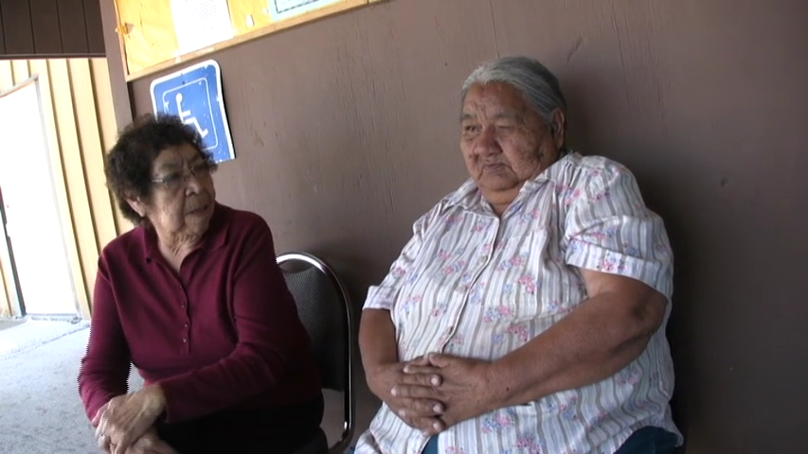
Targeted “others”
Example (3). 35b (10:06-10:23)
Notes:
RLCL or NP

Slide 18
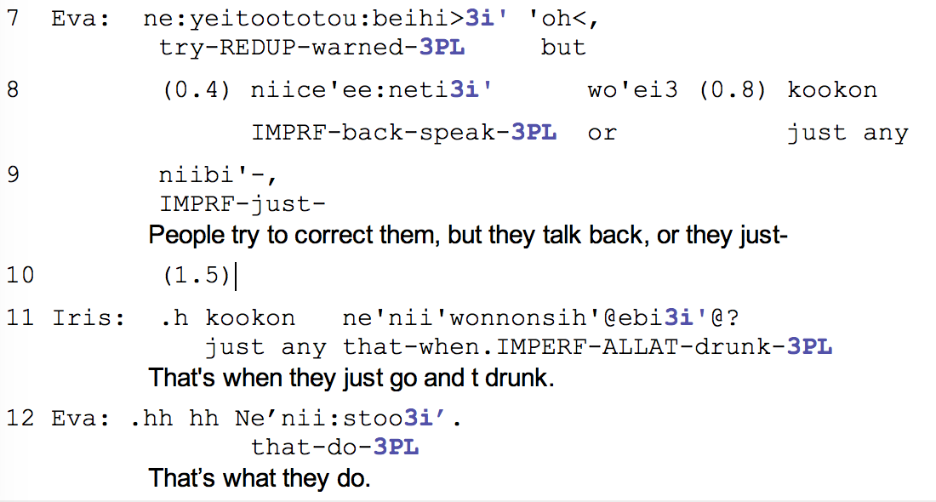
Targeted “others”
Example (3). 35b (10:06-10:23)

Slide 19
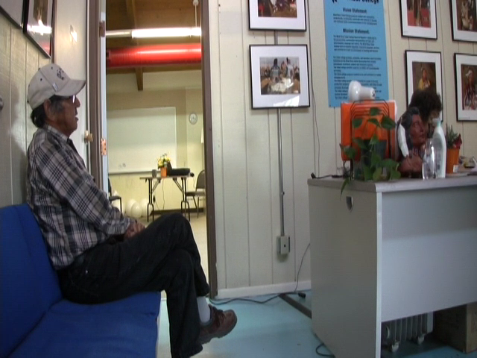
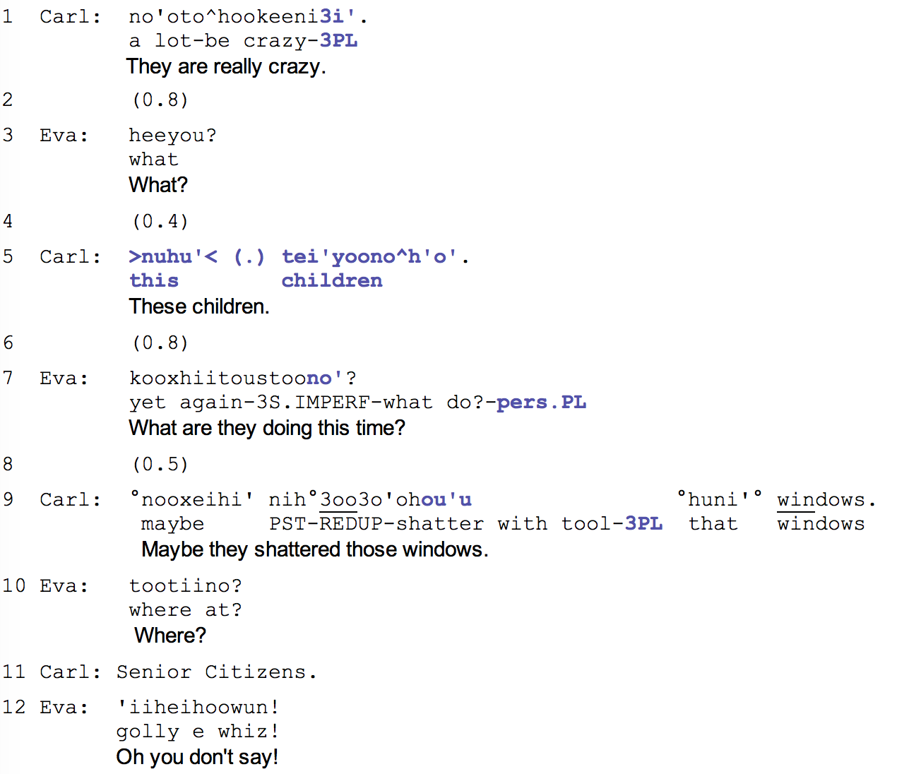
Targeted “others”
Example (4). Data 46a.

Slide 20
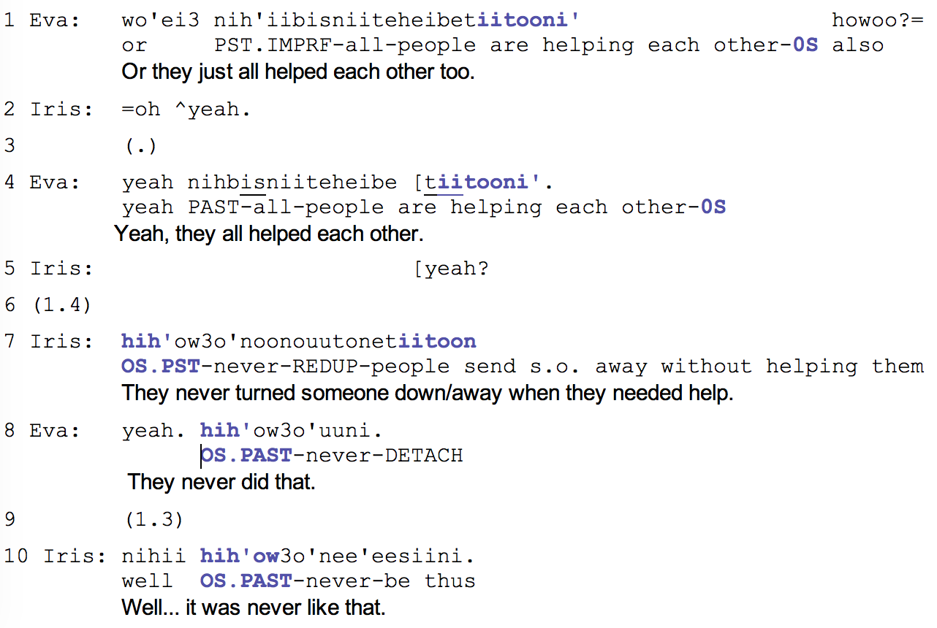
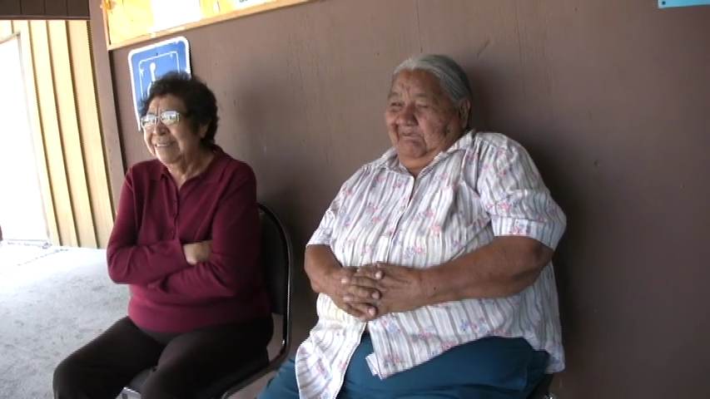
Everyone
Example (5). Data 35b (00:08-00:22).
Notes:
impersonal

Slide 21
Conclusion
Full singular NP form for complaining about individuals
No names or unique descriptors
Deducible from the context
Relative Clause or NP with 3PL inflections
For complaining about another group of people
No names, but RLCL provides enough info
These referents are not known to speakers
Impersonal forms to complain about community
Depersonalizes the main offender
Lifts responsibility
Requires no solution of a complained matter
Notes:
1)Reference for Targeted individuals is formed by a full NP: noun + determiner. Any following mention of the person is restricted to anaphoric verbal inflections, such as 3s. Importantly, when such form of reference is used, the identity of the individual is gathered from the previous context of the talk and it is only vaguely attributed by this NP not to cause any damage to the self representation of a person who doesn’t gossip.

Slide 22
References
Brown, P. (2007). Principles of person reference in Tzeltal conversations. In N. J. Enfield & T. Stivers (Eds.), Person reference in interaction: Linguistic, cultural, and social perspectives. (pp. 172–202). Cambridge, New York, Melbourne, Madrid, Cape Town, Singapore, Sao Paulo: Cambridge University Press.
de Fornel, M. (1987). Reference to persons in conversation. In J. Verschueren & M. Bertucelli-Papi (Eds.), The Pragmatic Perspective: Selected Papers from the 1985 International Pragmatics Conference (pp. 131–140). Amsterdam/Philadelphia: John Benjamins Publishing Company.
Enfield, N. J. (2007). Meanings of the unmarked: How “default” person reference does more than just refer, 97–120.
Fox, B. A. (1987). Anaphora in conversational English. In Anaphora and the structure of discourse (pp. 16–75). Cambridge: Cambridge University Press.
Heinemann, T. (2009). Participation and exclusion in third party complaints. Journal of Pragmatics, 41(12), 2435–2451. https://doi.org/10.1016/j.pragma.2008.09.044
Levinson, S. C. (2007). Optimizing person reference - perspectives from usage on Rossel Island. In N. J. Enfield & T. Stivers (Eds.), Person reference in interaction: Linguistic, cultural and social perspectives (pp. 29–72). Cambridge, New York, Melbourne, Madrid, Cape Town, Singapore, Sao Paulo: Cambridge University Press.
Sacks, H., & Schegloff, E. A. (2007). Two preferences in the organization of reference to persons in conversation and their interaction. In N. J. Enfield & T. Stivers (Eds.), Person Reference in Interaction: Linguistic, Cultural and Social Perspectives (pp. 23–28). Cambridge, New York, Melbourne, Madrid, Cape Town, Singapore, Sao Paulo: Cambridge University Press.
Schegloff, E. A. (1996). Some Practices for Referring to Persons in Talk-in-Interaction: Partial Sketch of a Systematics. In B. A. Fox (Ed.), Studies in Anaphora.
Stivers, T. (2007). Alternative recognitionals in person reference. In N. J. Enfield & T. Stivers (Eds.), Person Reference in Interaction: Linguistic, Cultural and Social Perspectives (pp. 73–96). Cambridge, New York, Melbourne, Madrid, Cape Town, Singapore, Sao Paulo: Cambridge University Press.

Slide 23
Go raibh maith agat!
Hohou!
Thank you!
Спасибо!
Kiitos!

